Slide 1
AiO E22 All-in-One Desktop Sales Kit
Ernest, Product Marketing

Slide 2
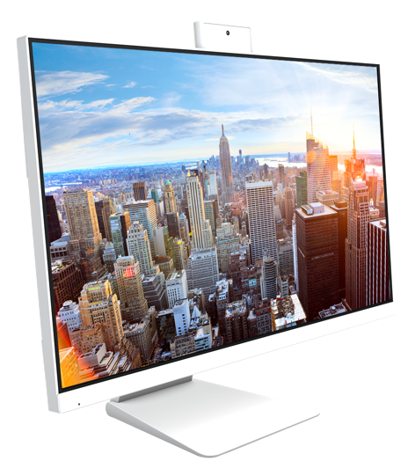
01. PRODUCT ONE-PAGER
02. PRODUCT FEATURES
03. PRODUCT VIEW
04. PRODUCT SPECIFICATIONS

Slide 3
21.5-inch
Full HD Display
178°
Wide-viewing Angle
10-point
Multi-touch (Optional)
VESA-mount
Compliant Design
Pop-up
2MP Full HD Camera
-5° ~ +65°
Tilt

Slide 4
Vibrant Visual
1 9 2 0
AiO E22 features a Full HD panel that delivers stunning visuals with outstanding color reproduction.
1 0 8 0

Slide 5
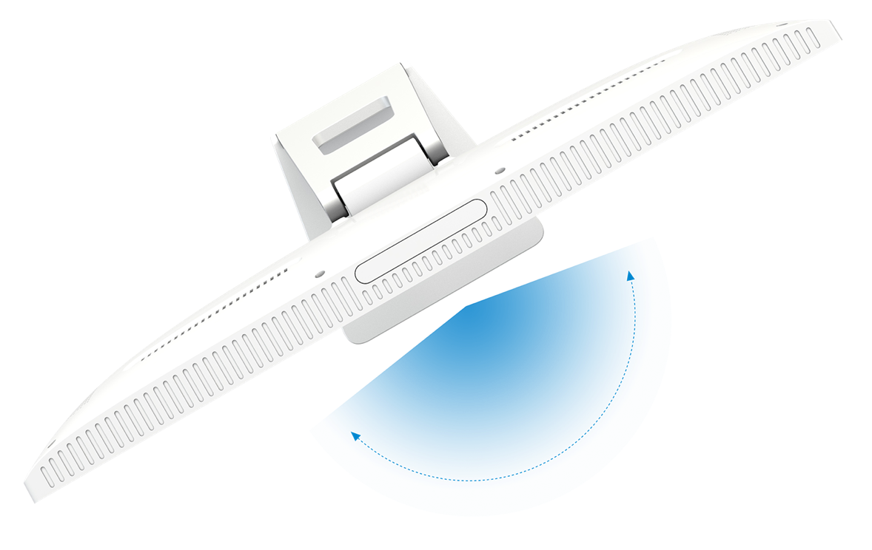
Catch All Details
AiO E22 features 178° viewing angle, both horizontally and vertically, so you can enjoy its beautiful visuals from almost any direction.
178°
Wide-viewing Angle

Slide 6
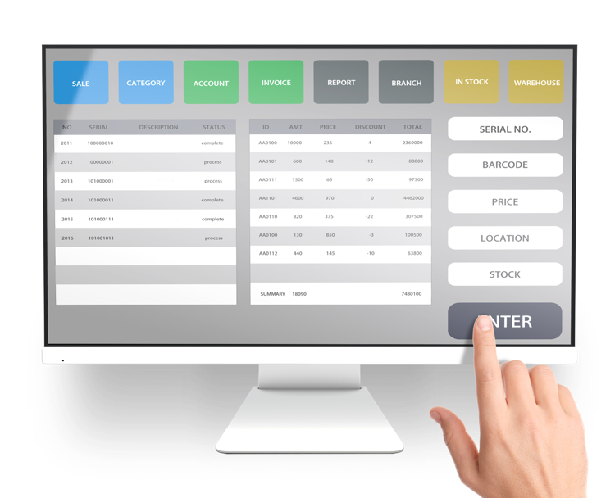
Tap into Productivity (Optional)
With responsive and intuitive 10-point touch screen, AiO E22 supports swipe, scroll, drag and pinch gestures to help you get tasks done more efficiently.

Slide 7
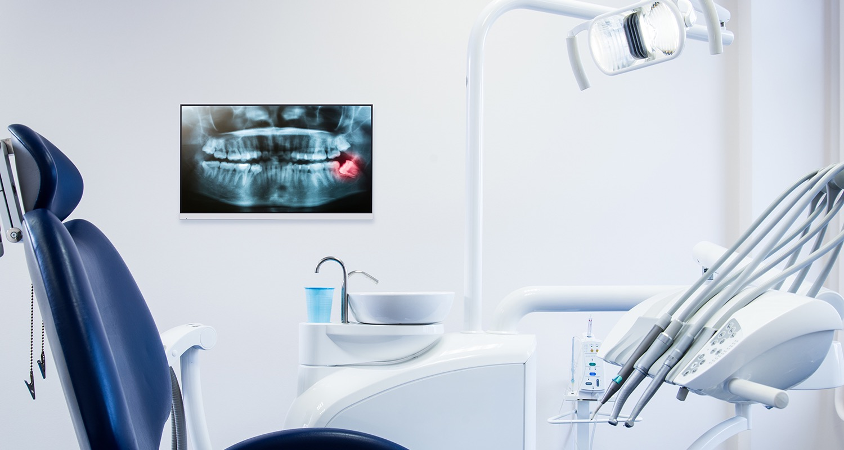
Ideal for Multiple Layouts
Adapt to different office layouts thanks to VESA-compatibility. Choose to mount AiO E22 to the wall or attach it to monitor arms and enjoy a more flexible workspace.

Slide 8
Enhanced Security
The pop-up 2MP Full HD camera with Infrared sensor hides safely out of sight when not in use and adds a layer of security with facial recognition through Windows Hello and Microsoft Skype™ for Business certification.

Slide 9
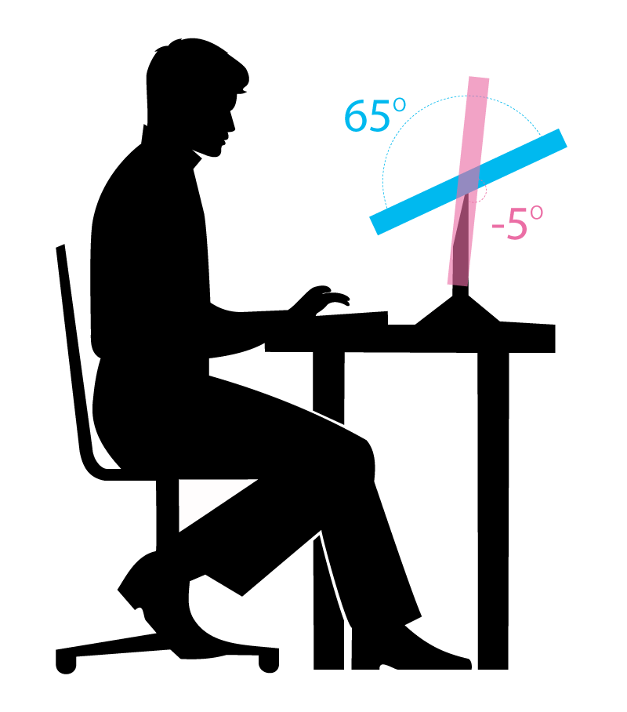
Ergonomic Design for Custom Comfort
Because its ergonomic stand offers tilt adjustments, AiO E22 provides a superb range of viewing options for increased productivity and comfort.
-5° ~ 65°
Tilt

Slide 10
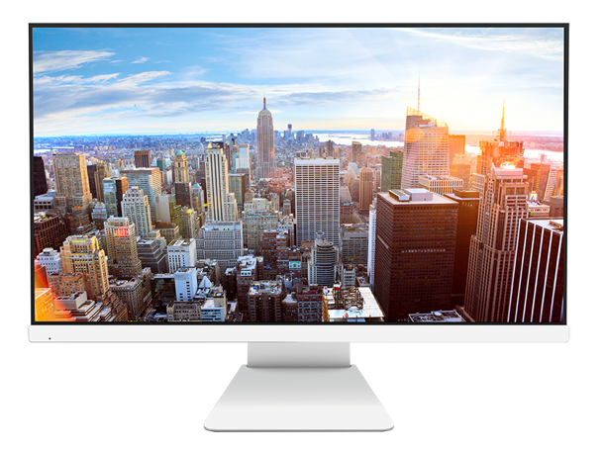
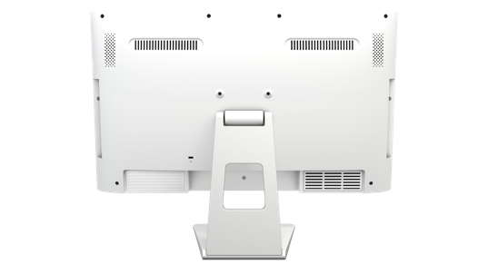
Product View
Front View
Rear View

Slide 11
Specifications
Screen | 21.5” | Input & Output | Side:
Motherboard | H310CH5-TI2 |  | 2 x USB 2.0
CPU | Support Intel® 9th & 8th Generation Processors |  | 2 x Audio jacks (1 x Headphone, 1 x microphone)
Display | Full HD with LED-backlight LCD |  | 1 x card reader
 | Support 10-point multi-touch (Optional)
 | 178° Wide-viewing Angle |  | Rear:
 | Aspect Ratio 16:9 |  | 2 x Audio jacks (1 x Headphone, 1 x microphone)
Graphics | Integrated Intel® HD Graphics |  | 1 x RJ-45
Memory | Support 2 x Dual Channel DDR4 SO-DIMMs |  | 1 x HDMI out
Storage | Support 1 x 2.5” Hard Disk |  | 1 x D-sub
 | Support 1 x M.2 2260/ 2280 slot for SSD |  | 2 x USB 2.0
Camera | 2 MP Webcam |  | 2 x USB 3.1 Gen1
ODD | 1 x Slim optical DVD-RW |  | 1 x 19V DC-in
Audio | 2 x 2 W speakers | Power Supply | 120W
Wireless | 802.11 a/b/g/n/ac & BT 4.2 | OS Support | Windows 10 64-bit

Slide 12
 | E22 | E24
Screen Size | 21.5" | 23.8"
CPU | Support Intel® 9th & 8th Generation Processors
Chipset | H310CH5-TI2
Display | Full HD with LED-backlight LCD Support 10-point multi-touch (Optional) 178° Wide-viewing Angle Aspect Ratio 16:9 | Full HD with LED-backlight LCD 170° Wide-viewing Angle Aspect Ratio 16:9
Graphics | Integrated Intel® HD Graphics
Memory | Support 2 x Dual Channel DDR4 SO-DIMMs
Storage | Support 1 x 2.5” Hard Disk Support 1 x M.2 2260 / 2280 slot for SSD
Camera | 2 MP Webcam | N/A
ODD | 1 x Slim Optical DVD-RW | N/A
Audio | 2 x 2 W speakers
I/O | Side: 2 x USB 2.0 2 x Audio Jacks (1 x Headphone, 1 x microphone) 1 x Multi card reader Rear: 2 x Audio Jacks (1 x Headphone, 1 x microphone) 1 x RJ-45 1 x HDMI out/ 1 x D-sub 2 x USB 2.0/ 2 x USB 3.1 Gen 1 1 x 19V DC-In | Side: 2 x USB 2.0 Rear: 2 x Audio Jacks (1 x Headphone, 1 x microphone) 1 x RJ-45 1 x HDMI out/ 1 x D-sub 2 x USB 2.0/ 2 x USB 3.1 Gen 1 1 x 19V DC-In
Wireless | WLAN 802.11 a/b/g/n/ac & BT 4.2
OS Support | Windows 10 64-bit
Power Supply | 120W

